Slide 1
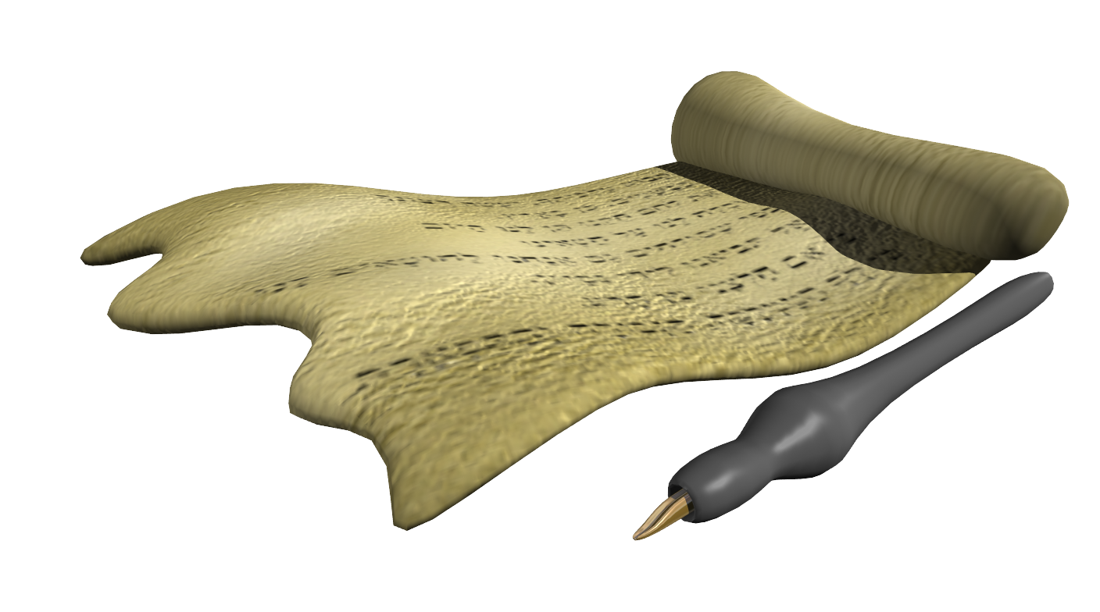
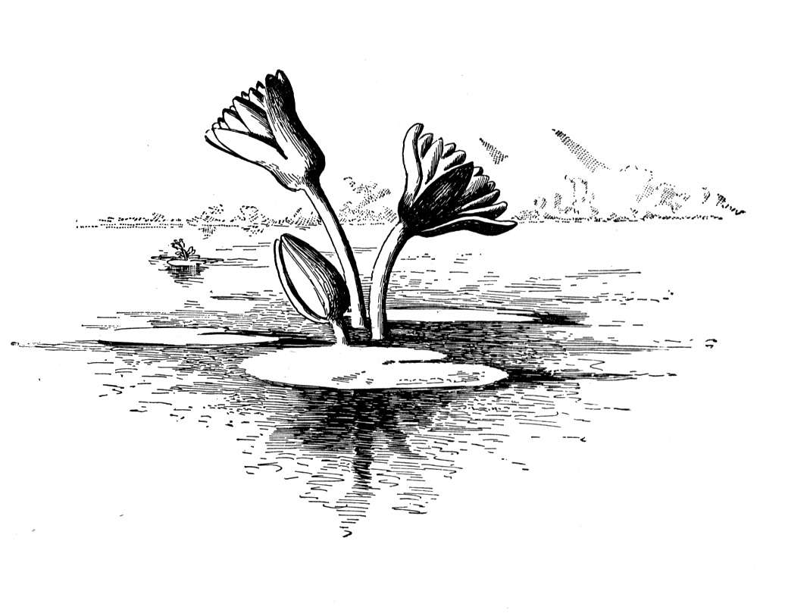
Messages In Malachi
(my messenger)
“The burden of the word of the LORD to Israel by Malachi” (1:1)
Date: ca. 430 BC (Days of Nehemiah)
Old Testament Placement: last of minor prophets
Style: reasoner
Notes:
[CLICK]
From Nehemiah 13:6 we learn in the 32nd year of Artaxerxes 433-32 BC, Nehemiah was recalled back to Persia perhaps to give account of his work. During this time many evils were allowed to incubate and hatch among Israel. When Nehemiah returned he was disgusted what he had seen. Ezra was probably dead by this time and unless God had raised up Malachi, Nehemiah would probably have had to meet these challenges alone.

Slide 2
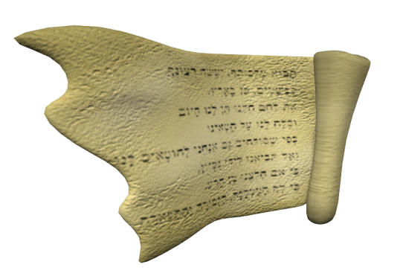
Problems In Malachi's Time
neglect of temple service (1:12, 13; Neh. 13:4, 5)
withholding of tithes (3:8; Neh. 13:10)
outward observances with no inward devotion
partiality in the priesthood (2:1-9; Neh. 13:4, 29)
repudiation of legitimate wives (2:13-16)
remarriage with alien women (2:11; Neh. 13:23-27)
harsh words against God (1:7; 2:17; 3:13)
widespread skepticism

Slide 3
Message of Blindness
blind to God’s love (1:2)
“I have loved you” (LORD)
“In what way have you loved us?” (Israel)
beware not to forget past mercies
“they believed His words…they soon forgot His works” (Ps. 106:12, 13)
Notes:
[CLICK X2] Israel was blind to God’s love even though God surely loved them. It reminds me of a disobedient child with all kinds of foolishness bound up in him screaming at his parents that “you don’t love me” when they simply try to instruct him or deny him something harmful or discipline him against what is wrong. Regardless of the fact that his parents sacrificed limitless time, sleeplessness, money and perhaps even health for his well-being; regardless of all the food, clothing and shelter they have provided; regardless of all the entertainment they have provided; the child has erased all from his mind and mouth every decent deed done and screams “you don’ t love me.”
In reality, it is the child who lacks to show love and gratitude to his parents for all that they have done and for all that they are. “The eye that mocks his father, And scorns obedience to his mother, The ravens of the valley will pick it out, And the young eagles will eat it” (Prov. 30:17). Unless corrected, such a one is on a collision course with death.
Israel forgot that God had provided her with a rich history of protection securing her from those who hated her and yet all she can now see is that God is mean and withholding any good.
Some do that today when calamity strikes. A disrespectful terrorist starts fires in California and some people wonder why God would do that to them. If that is not equating God with an arsonist, I don’t know what it is. To make matters worse, News programs have false teachers like Joel Osteen on who when asked such a question like this only skirts the issue and tells people that we just need to love God and know that God loves us. Mr. Osteen, if he would get back to the Bible would soon discover that there is another being who walks the face of the earth seeking to devour—Satan (cf. 1 Pet. 5:8). He would learn soon learn that all people either work for God or for Satan and all of our deeds are “in God” or “in the devil” and that repercussions will follow.
Others question God’s love today when they castigate and make fun of God’s love because He has created a place of hell provided for those who do not love and obey Him in return. They make fun of Him by suggesting that God is an evil tyrant who if you don’t love, then he will just send you to hell to burn. They reduce God as simply a being that must give all; love all, provide for all, accept all regardless of what man may do. They also elevate man as one who must be able to give none, love none and yet still be acceptable to God???
[CLICK]

Slide 4
Message of Blindness
blind to God’s love (1:2)
blind to guilt (1:6)
“Where is My honor?” (LORD)
“In what way have we despised Your name?” (Israel)
we forget we are dust and ashes
we forget God is “a great King,” “Master,” “Father,” etc.
“But Simon answered and said to Him, ‘Master, we have toiled all night and caught nothing; nevertheless at Your word I will let down the net’…When Simon Peter saw it, he fell down at Jesus’ knees, saying, ‘Depart from me, for I am a sinful man, O Lord!’” (Lk. 5:5, 8)
Notes:
[CLICK X2] They were also blind to their own guilt. They couldn’t see how they failed in honoring God. Yet this is a real danger that can creep into God’s camp anywhere at anytime when we forget two things [CLICK X2].
[CLICK] Simon Peter was an experienced fisherman and toiled all night to get a good catch but got skunked. After a frustrating and tiresome evening, he saw Jesus by chance wanting his boat to go out a little in the sea and teach the people. After Jesus was done teaching, He asked Peter to launch out into the deep and let down his net. It didn’t make any sense because Peter had already tried fishing the best places at the best time and got nothing. But he retains his humility and when he catches a large number of fish, he is overwhelmed by his own sinful state next to the Jesus.
It is easy to get caught up in our work, in our wisdom, in our thinking, in our jobs, in our careers and forget that we are a sinful man in need of deep humility and the forgiveness of God.

Slide 5
Message of Blindness
blind to God’s love (1:2)
blind to guilt (1:6)
blind to defiling the Lord’s Table (1:7, 12-14)
“by saying, ‘the table of the LORD is contemptible’” (1:7)
“when you offer the blind” (1:8)
We can defile the Lord’s Table under the New Testament by:
not examining ourselves
not giving thanks
partaking in an unworthy manner (e.g., common meal)
provoking the Lord to jealousy by placing something before Him
1 Cor. 10:21, 22; 11:27-34
Notes:
They were also blind to defiling the Lord’s table [CLICK X2]
[CLICK] We can defile the Lord’s Table today too if we are not careful. We have no less to expect God to be any less angry if we do! How might we spoil the table of the Lord?
[CLICK X5]

Slide 6
Message of Blindness
blind to God’s love (1:2)
blind to guilt (1:6)
blind to defiling the Lord’s Table (1:7, 12-14)
blind to massacring marriage (2:11-16)
man’s relationship with God affects his relationship with others (2:10)
man’s relationship with others affects his relationship with God (2:13)
a sin against God’s children is a sin against God (v. 11; cf. Matt. 25:45)!
Notes:
[CLICK thru] “Then He will answer them, saying, ‘Assuredly, I say to you, inasmuch as you did not do it to one of the least of these, you did not do it to Me.” (Matt. 25:45)

Slide 7
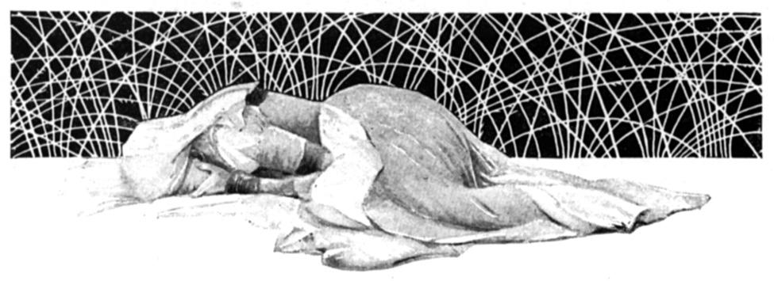
The Weeping Wife May Negate The Sacrfice of the Husband!
Malachi 2:13
1 Peter 3:7
“And this is the second thing you do: You cover the altar of the LORD with tears, With weeping and crying; So He does not regard the offering anymore, Nor receive it with goodwill from your hands”
“Husbands, likewise, dwell with them with understanding, giving honor to the wife, as to the weaker vessel, and as being heirs together of the grace of life, that your prayers may not be hindered”
“with whom you have dealt treacherously” (2:14)
“with whom you have not dwelt with understanding”

Slide 8
Message of Blindness
blind to God’s love (1:2)
blind to guilt (1:6)
blind to defiling the Lord’s Table (1:7, 12-14)
blind to massacring marriage (2:11-16)
blind to wearying God (2:17)
with words!
false accusations against God
“to execute judgment on all, to convict all who are ungodly among them of all their ungodly deeds which they have committed in an ungodly way, and of all the harsh things which ungodly sinners have spoken against Him” (Jude 15)
it does matter what we say!
Notes:
[CLICK X2]The internet is filled with harsh and hateful language against God. God will bring all these into judgment. [CLICK]

Slide 9
Message of Blindness
blind to God’s love (1:2)
blind to guilt (1:6)
blind to defiling the Lord’s Table (1:7, 12-14)
blind to massacring marriage (2:11-16)
blind to wearying God (2:17)
blind to the nature of the Lord’s 1st coming (3:1-3; 4:1ff)
not going to be as they expected
condemnation upon Israel rather than Israel’s enemies
fulfilled: Matt. 3:7-11; Jn. 2:13-16

Slide 10
Message of Blindness
blind to God’s love (1:2)
blind to guilt (1:6)
blind to defiling the Lord’s Table (1:7, 12-14)
blind to massacring marriage (2:11-16)
blind to wearying God (2:17)
blind to the nature of the Lord’s 1st coming (3:1-3; 4:1ff)
blind to their history of leaving God (3:7)
Notes:
Israel was blind to their leaving God which is why they asked “in what way shall we return?” They do not see themselves as needing to return. Awe, the self-righteousness of the Pharisee movement is hereby in its infancy.

Slide 11
Message of Blindness
blind to God’s love (1:2)
blind to guilt (1:6)
blind to defiling the Lord’s Table (1:7, 12-14)
blind to massacring marriage (2:11-16)
blind to wearying God (2:17)
blind to the nature of the Lord’s 1st coming (3:1-3; 4:1ff)
blind to their history of leaving God (3:7)
blind to robbing God (3:8)
in support of Levites (Lev. 27:30-33; Deut. 12:1-19)
Levites in supporting high priest (Num. 18:21-32)
Notes:
There are ways that they could have robbed God by withholding the tithe for the priests (CLICK X2)

Slide 12
Thoughts on Robbing God
the thought of being robbed
ways we rob God
withholding ourselves from Him (Rom. 12:1)
withholding a proper spirit in giving (2 Cor. 9:7)
withholding a proper amount (2 Cor. 8:12)
why we rob God
deluded into thinking God is more relaxed today
won’t listen to what He wants
willfully worldly
over-occupational – allowing the world and self to fill us
Notes:
“I beseech you therefore, brethren, by the mercies of God, that you present your bodies a living sacrifice, holy, acceptable to God, which is your reasonable service” (Rom. 12:1)
“So let each one give as he purposes in his heart, not grudgingly or of necessity; for God loves a cheerful give” (2 Cor. 9:7)
“For if there is first a willing mind, it is accepted according to what one has, and not according to what he does not have” (2 Cor. 8:12). You need to ask, am I really giving according to what I have or according to what I have left over after I have spent it on my own pleasure? Would the government accept taxes that way? Would God accept His offering that way?

Slide 13
Message of Hope
of Gentiles (1:11)
of Messiah’s coming (3:1)
of true worship restored (3:3)
of being remembered by God (3:16)
of adoption performed (3:17)
Notes:
Please understand that the prophet also employed messages of hope for his people. He rebuked their sins and took on their skepticism but also gave reason to rejoice. [CLICK thru]

Slide 14
Why Not Become A Child of God?
14 “For as many as are led by the Spirit of God, these are sons of God.
15 For you did not receive the spirit of bondage again to fear, but you received the Spirit of adoption by whom we cry out, "Abba, Father."
16 The Spirit Himself bears witness with our spirit that we are children of God,
17 and if children, then heirs––heirs of God and joint heirs with Christ, if indeed we suffer with Him, that we may also be glorified together.
Romans 8:14-17

Slide 15
The Spirit Leads To Be Baptized
“In this the children of God and the children of the devil are manifest…” (1 Jn. 3:10)
26 For you are all sons of God through faith in Christ Jesus.
27 For as many of you as were baptized into Christ have put on Christ.
Galatians 3:26, 27
Children of Devil
Children of God
FAITH
BAPTISM
Notes:
[CLICK X2]

